Slide 1

Team 1 - Spring-Alert
User Management & Notification Management Services
Source code Repo: https://github.com/BUMETCS673/project-teamfirst
Notes:
Our vision as driven by Jordany was that we would combine with the other groups for the purpose of providing various microservices that would all later be coupled together to provide a larger offering. As a team we took on the User management & Notification Management system.

Slide 2
Team Members
Team Member | Role(s)
Jim Penner | Group Leader,
Jordany Arnaud | Design & Implement Leader, Security Leader
Chaozheng Zhu | Configuration Leader, QA Leader
Shenxiao(Sherry) Li | Requirement Leader, Design & Implement Leader
Notes:
I suggest that between Sherry and Jordany that they discuss at beginning what was the overall goal of our Project. Then hand to Jim re: Testing and Metrics

Slide 3
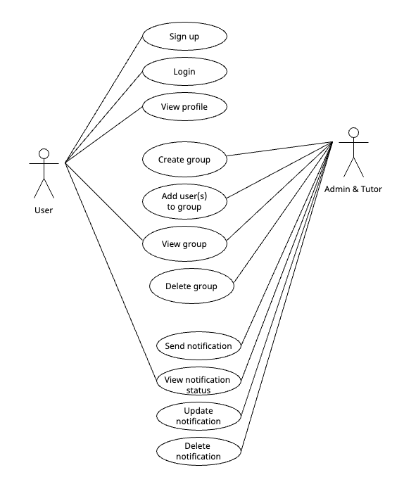
Requirement Analysis
User Management
Sign up
User registration
View Profile
Manage profile
Group Management
Create group
Add user(s) to group
View group
Delete group
Notification Service
Send notification
View notification status
Update notification
Delete notification
Notes:
Jim to discuss here- both functional and non-functional requirements

Slide 4
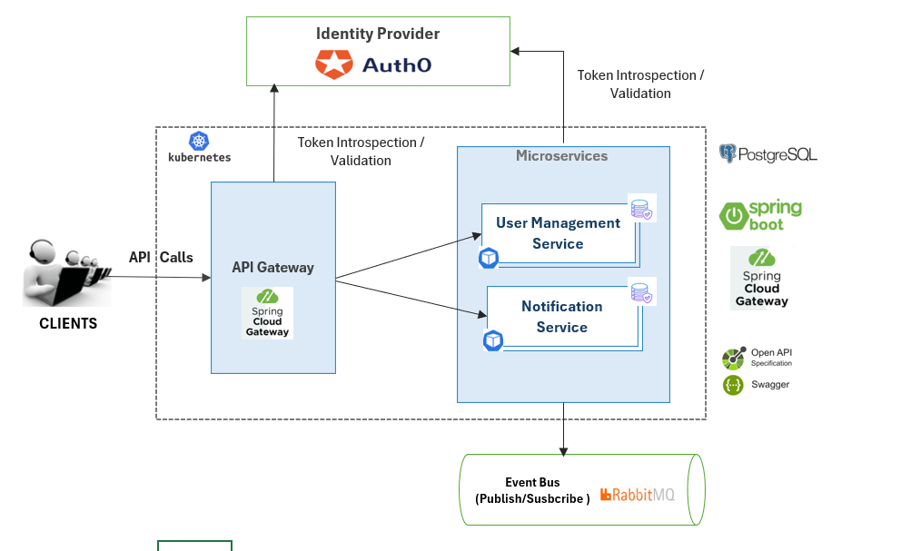
High Level Design
Notes:
Sherry: +API getaways(not able to complete)

Slide 5
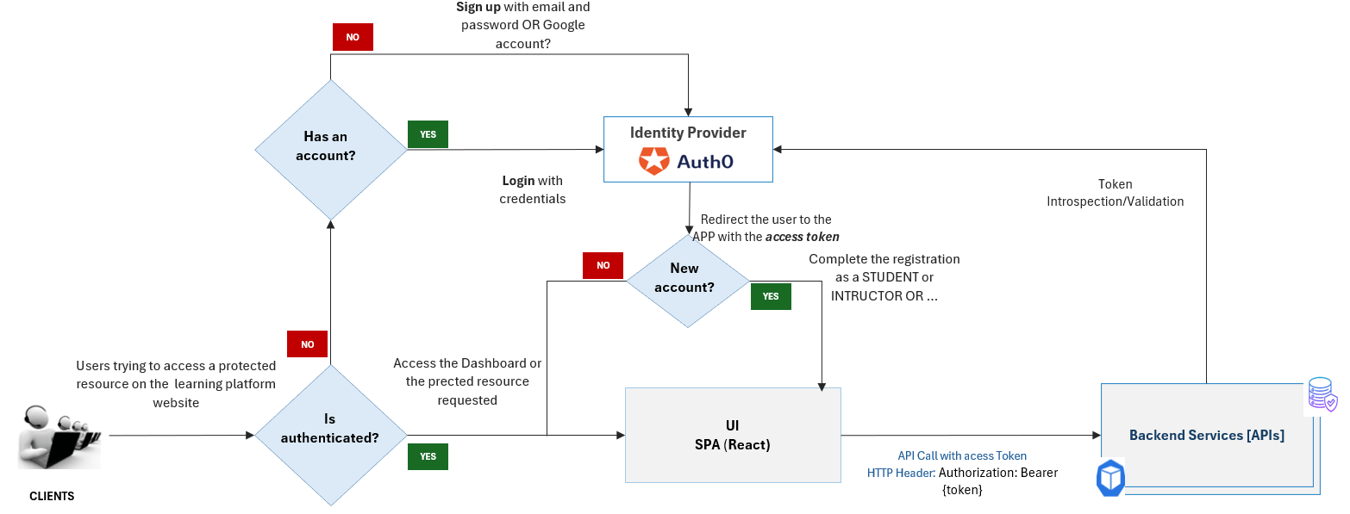
Registration flow - Integration with UI
Notes:
Jordany

Slide 6


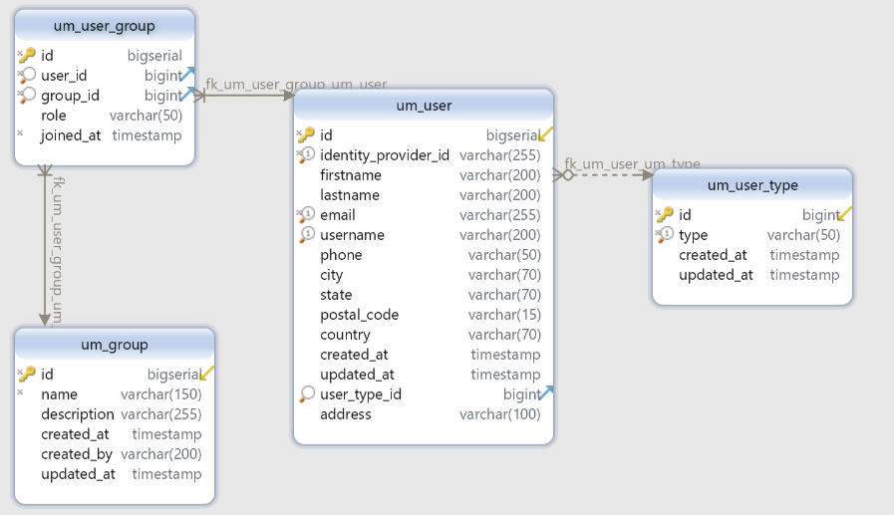
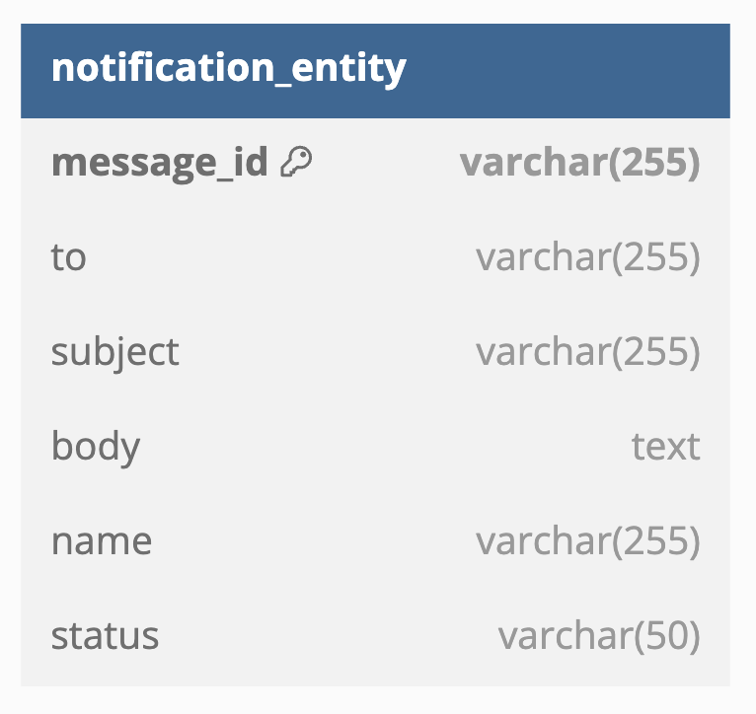
Database Design
PostgreSQL
Cockroach
User Management
Notification Schema
Notes:
Sherry

Slide 7
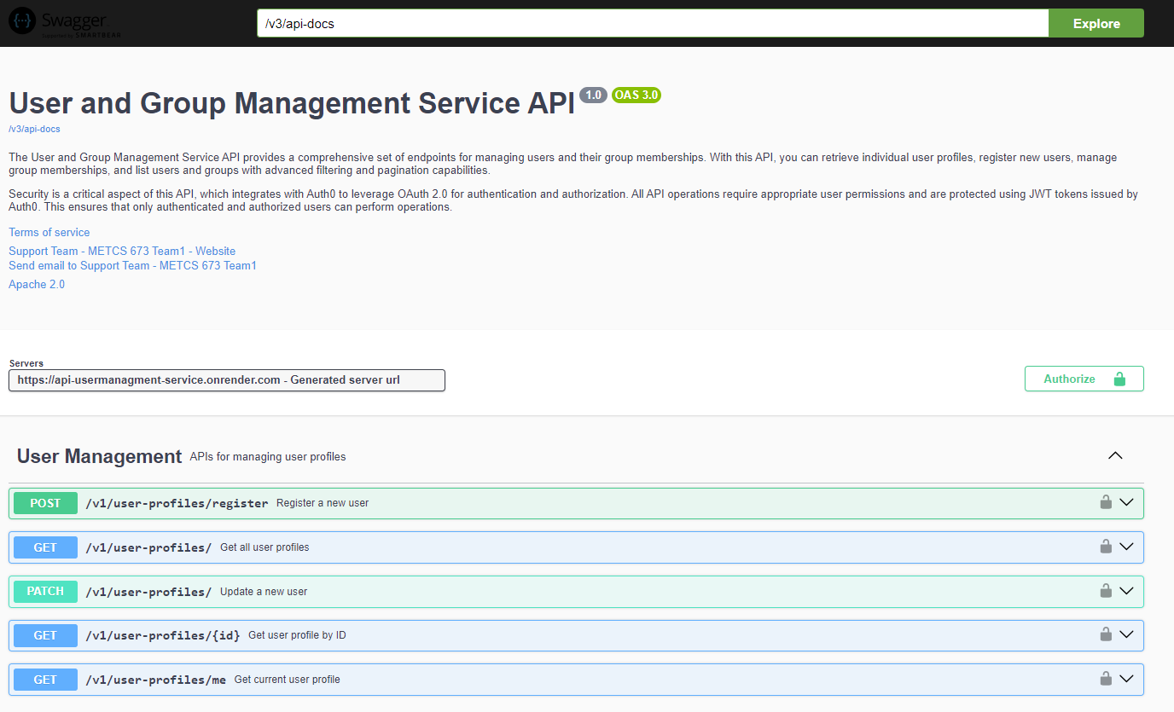
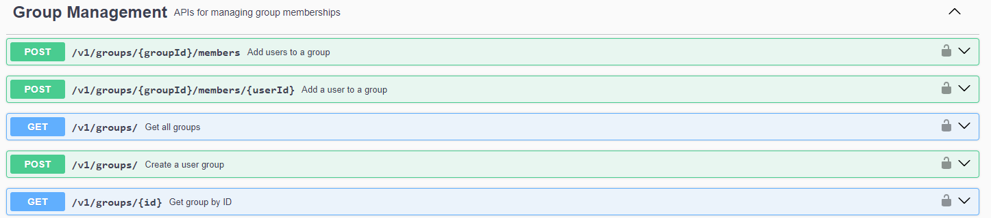
API Design
User Management Service Swagger Doc
Notes:
Sherry

Slide 8
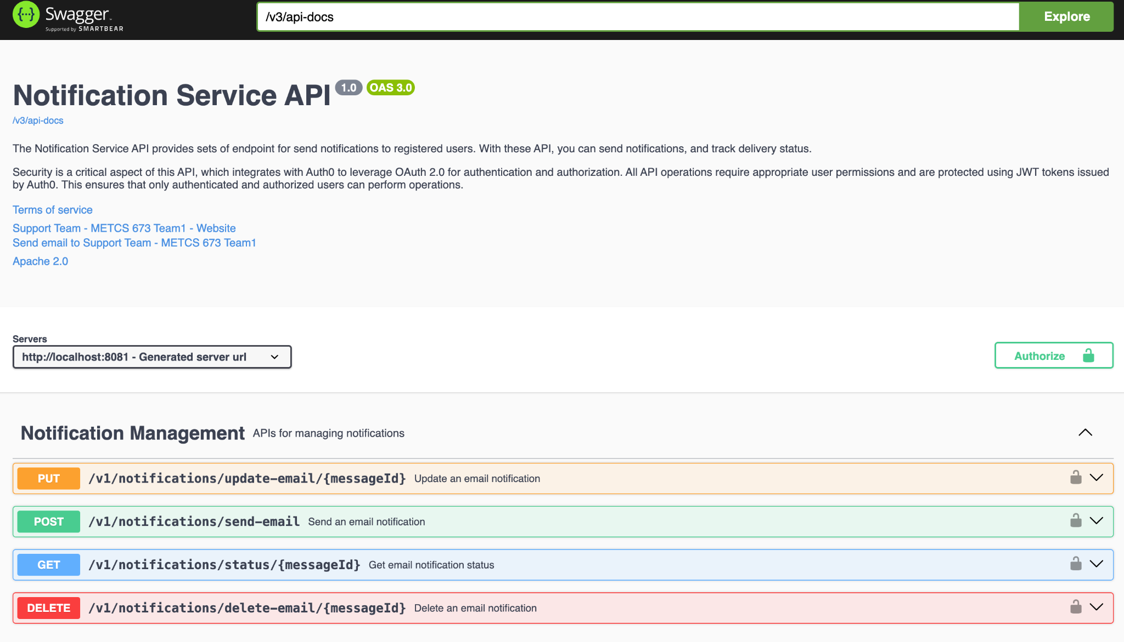
API Design
Notes:
Sherry

Slide 9
Implementation
Tech stacks:
Spring boot
Cockroach for database
Docker
Rencher for the deployment
Git/GitHub
IntelliJ /Eclipse
Java 17
Swagger
Coding Standard:
Overall principles
Error handling
Logging
API Design Standard
Branching
Main branch : stable branch
Branch per iteration
Notes:
Jordany: reference: SPPP files

Slide 10
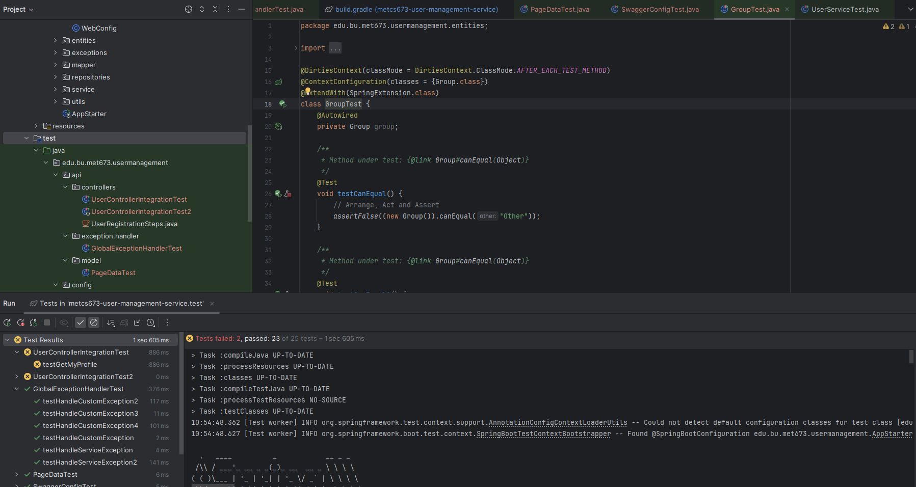
Testing-User Management
Metrics : In UserManagement 51/62 tests passed
Junit Test : See the screenshot of a UserManagement Unit Test
Manual Test(Postman): See demo, or add screenshot
Notes:
Jim - will we eventually have a Postman screenshot here
I have one, and so if we add it later, that miht be fine

Slide 11



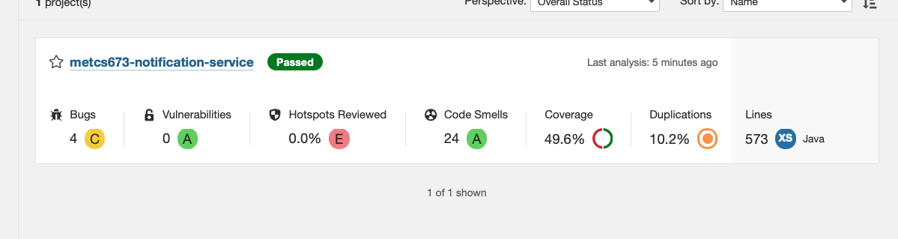
Testing - Notification
Notes:
Chao to present on Sonarqube

Slide 12
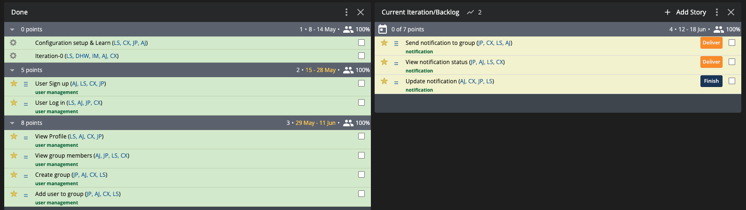
Achievements
Complete 13 points;
Everyone played a vital role and made a lot contribution

Slide 13
Risk & Challenges
Lost 2 group members
Improve collaboration
Learning Curve
e.g.
With Integration testing, more complex, uses more resources and had issues with security aspects of testing API integration: Jim
Integrating different plugins, following video resources always facing the issue version has been outdated or Java version different than our current project: Chao
Integrating SpringBoot with RabbitMQ ensuring that the notification service can scale to handle varying loads - Sherry
Notes:
All - Jim to provide broad overview that “As you can see here, each of us encountered various challenges, and yet with collaboration and patience we ended up producing a decent result”

Slide 14
Lesson & Learn
Be more realistic
e.g
Need to apply more agile aspects to my coding. Need to code, then test, and refactor as I went along: Jim Penner
While applying new plugin, it's better to go through the whole process first, so that have a basic idea how long and difference it take to implement to our project.
Biggest learning is on SonarQube and Jacoco for testing and coverage: Chao
Notes:
all

Slide 15
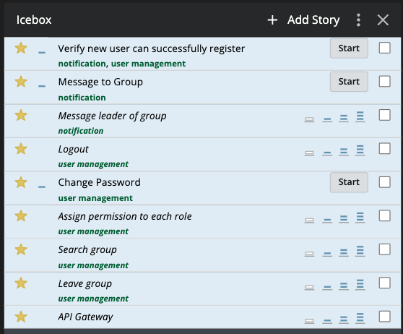
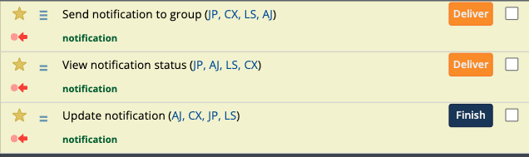
Future Work
Notes:
reference: pivotal tracker- icebox

Slide 16
Demo
Link:
Team1: Spring_Alert -> Project Demos & Presentation -> Final videos
https://drive.google.com/drive/u/3/folders/1-Rl6M_T8mZ0lL7wvXcNq5fZwLsJuvQGS

Slide 17
Thank you!

